Slide 1
Home
XBOX
PlayStation
Contact us
THIS IS A DROPDOWN
This is a automatic carousel
NEWEST ITEMS
177 x 180
177 x 180
177 x 180
177 x 180
177 x 180
177 x 180
SKIN
HOME XBOX PLAYSTATION Contacts
Visit our Facebook and Twitter social media sites

Slide 2
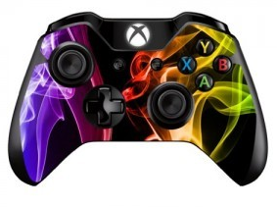
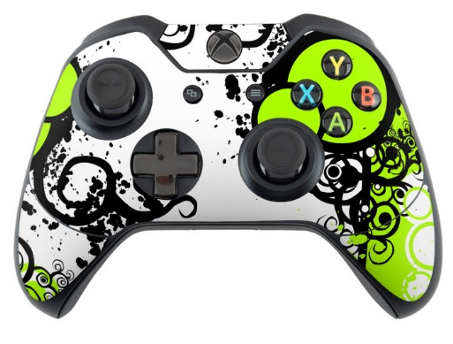
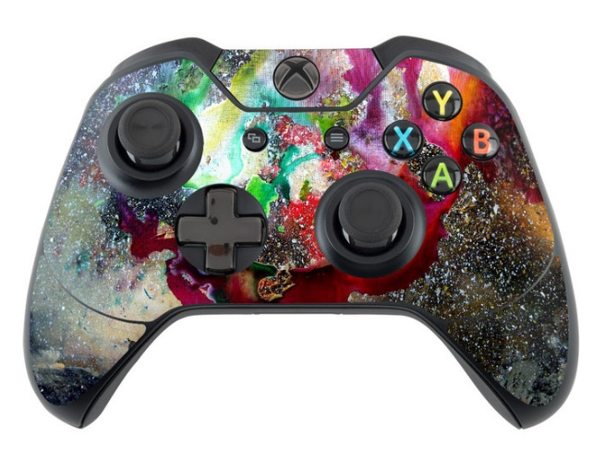
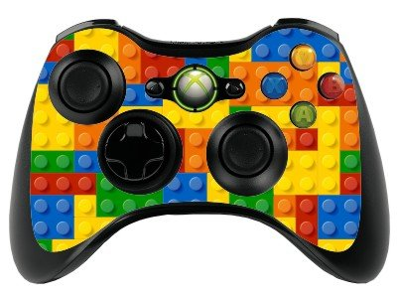
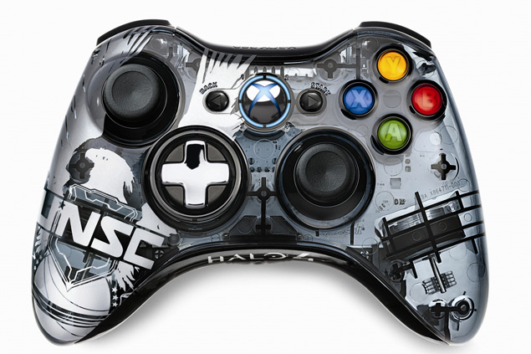
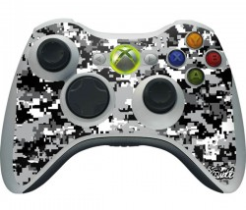
Home
XBOX
PlayStation
Contact us
THIS IS A DROPDOWN
XBOX ONE
NAME
£5.00
NAME
£5.00
NAME
£5.00
ADD TO CART
ADD TO CART
ADD TO CART
«
1
2
3
4
5
»
XBOX 360
NAME
£3.00
NAME
£3.00
NAME
£3.00
ADD TO CART
ADD TO CART
ADD TO CART
«
1
2
3
4
5
»
SKIN
HOME XBOX PLAYSTATION Contacts
Visit our Facebook and Twitter social media sites

Slide 3
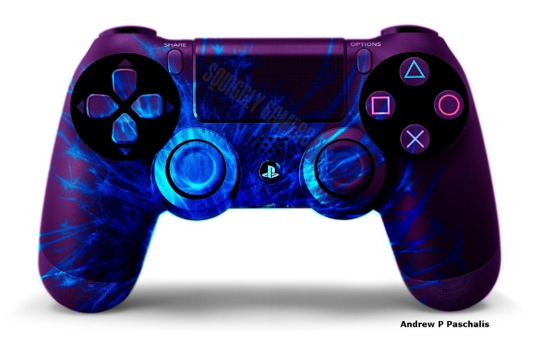
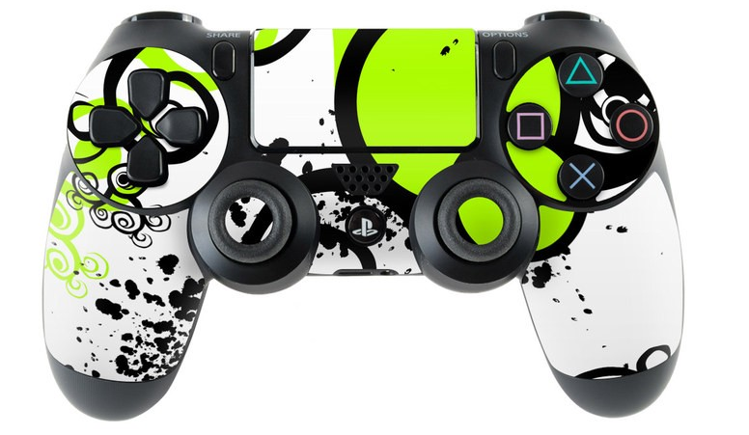
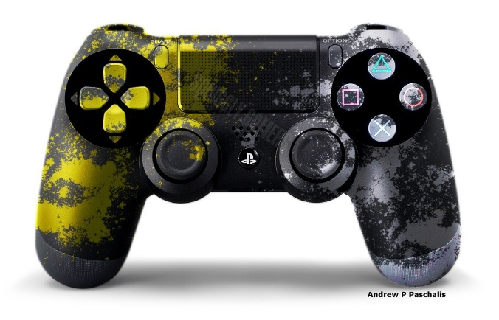
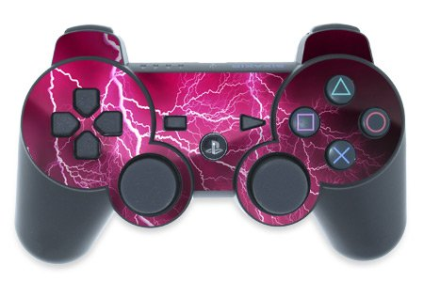
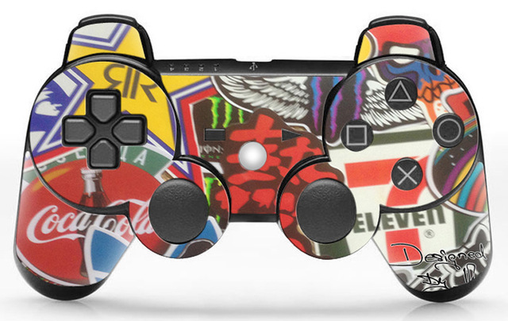
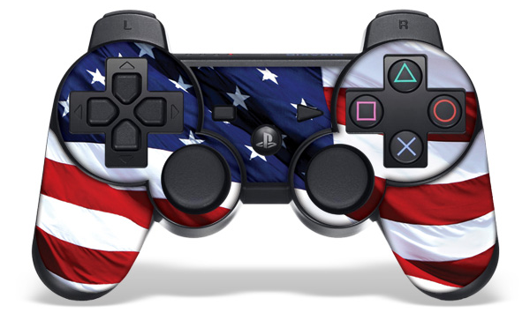
Home
XBOX
PlayStation
Contact us
THIS IS A DROPDOWN
PlayStation 4
NAME
£5.00
NAME
£5.00
NAME
£5.00
ADD TO CART
ADD TO CART
ADD TO CART
«
1
2
3
4
5
»
PlayStation 3
NAME
£3.00
NAME
£3.00
NAME
£3.00
ADD TO CART
ADD TO CART
ADD TO CART
«
1
2
3
4
5
»
SKIN
HOME XBOX PLAYSTATION Contacts
Visit our Facebook and Twitter social media sites

Slide 4
Home
XBOX
PlayStation
Contact us
THIS IS A DROPDOWN
CONTACT US
ANY PROBLEMS?
NAME:
EMAIL:
RE-TYPE EMAIL:
PROBLEM:
ACCOUNTS
MAP OF OUR SITE
LOG IN
SIGN UP
OUR EMAIL IS: HELP@SKINZ.COM
SKIN
HOME XBOX PLAYSTATION Contacts
Visit our Facebook and Twitter social media sites

