Slide 1
Unit 3- Assignment 1
By Alex Parker

Slide 2
QUANTITATIVE RESEARCH
Program Ratings
Program ratings are the ratings of programs, one of the best sites to see data is; www.barb.co.uk. From this site we can get the different channel audience viewing figures. The most popular site for the 29th to the 6th of march was BBC one, followed by ITV, BBC2 and then Channel 4. The most popular show in this week from channel 4 was “Goggle-box” and from BBC one it was “Call the midwife”. From the BARB website you can see what people your age or similar is watching and this might make you want to watch that type of program. Magazines and newspapers will include a section of what is coming up in that week and it will include the program channel it is on. They will also include a section about what the basic storyline is throughout.
In the US, they will have the age rating in the corner. These are set out like: TV-Y (suitable for children), TV-Y7 (suitable for people aged 7 years or above), TV-G (programs for all ages), TV-PG (Parental guidance is necessary), TV-14 (unsuitable for people under the age of 14), TV-MA (Only suitable for people who are a adult). Next to these they may also include the following letters to warn adults about things; D – Suggestive dialogue, L- Coarse language, S- Sexual content, V – violence. They don’t have to be bad like these ones aren’t: FV – Fantasy violence, E/I – educational / informative.

Slide 3
QUANTITIVE RESEARCH
Web Hits
Web hits are the amount of hits or views on a web page. The most popular 3 websites in the UK are: Google, Facebook, YouTube. This is according to the site called www.similarweb.com this shows the top 50 websites that are popular in the world or in specific countries. The company will analyse about 80 Million websites and 3 million games/ applications. All of this data is split up into 240 categories and into 60 countries. The site will also range from small business to global businesses. The term “hit” means the amount of views a web page has on it, this means that the more views a site has the more popular it will become.

Slide 4
QUANTITVE RESEARCH
Sales CD’s and DVD’s
The sales of DVD’s and CD’s have gone down recently down to everything going online, as you can get things on either iTunes or on illegal websites. The sales of CD’s and DVD’s have now started to rocket online as people can get them free on Netflix after they have paid a extremely low price, they will get a lot of films and Tv shows, the company will add and remove films and shows depending on how the file sizes are to stream and how they are popular or not.

Slide 5
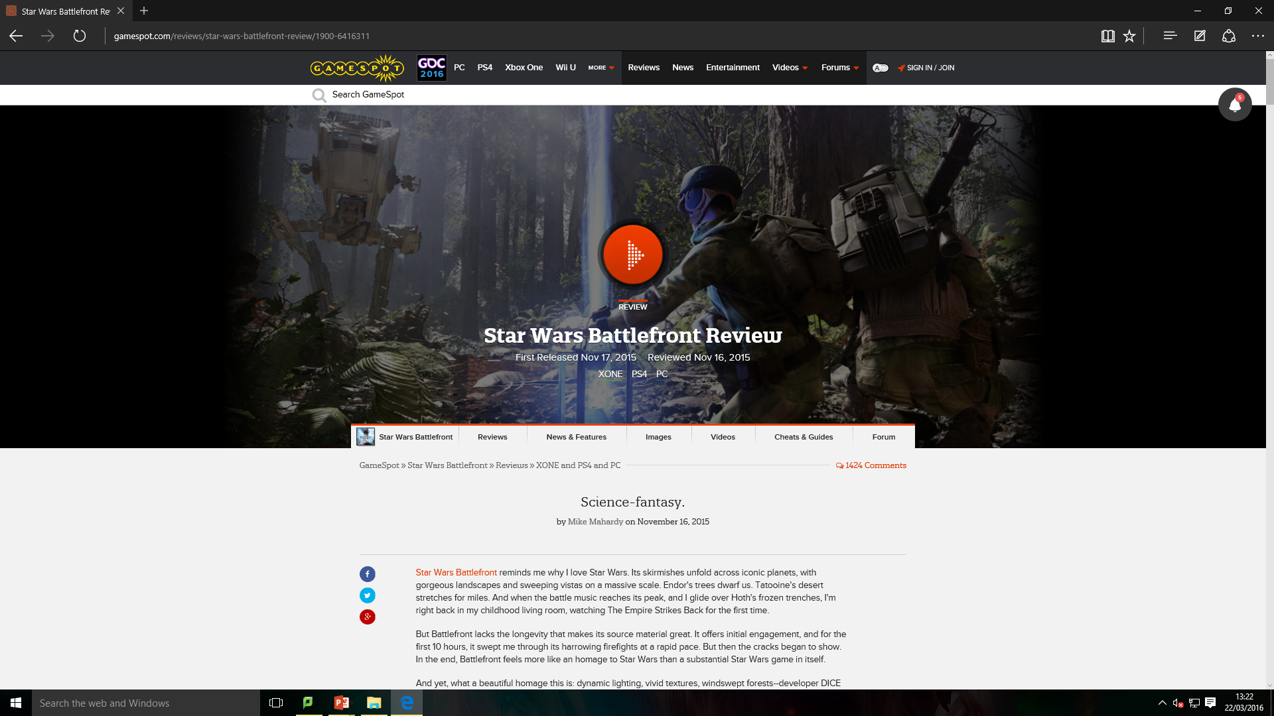
QUALTITIVE RESEARCH
Game reviews
A game review is a review of a game, these are made by the users of the game from this people can see weather they like it and want to buy the game. The reviewer can rate the game from one to ten, one being very bad and ten being the greatest game they have ever played. They can also include some screenshots of the game so they can see some of the layout features. Each website will include some gameplay maybe with the voiceover or commentary. On these websites they show the game at the best price, on each different platform.

Slide 6
QUALITATIVE RESEARCH
Fanzine Research
A fanzine is a mix between fan and magazine, this is a magazine for fans of a certain activity, hobby or thing. This can be quite popular in a smaller group of people. They are more popular with sports, especially football. http://www.standamf.com/a-to-zine-the-stand-fanzine-directory/ ← this website can take you to the football clubs very own fanzine. This website tells you the name of the fanzine, the printing layout, this will also tell the established date of the club and the magazine. The higher up it is the better views it has. You can change this later on to a-z to see your favorite club better.

Slide 7
QUALITITVE RESEARCH
Responses to advertising campaigns
A advertising campaign is a campaign that has been show to a mass amount of people, The part of making an advertising campaign is determining the best type of theme to get more audience members, it will set up the tone for the adverts and is a other form of marketing. The campaign theme is the central message or the message you want to be heard that will be communicated in the campaign, The campaign themes are usually developed with the intention of being used for a special or specific time period depending on the market conditions and/or competition in the marketplace.

Slide 8
PRIMARY RESEARCH
Questionnaires
Questionnaires are a few questions on a piece of work, that will ask about the topic. Questionnaires have advantages over surveys as they are cheap and not expensive to produce, do not require as much effort from the questioner they just fill it out whereas you have to speak with surveys, and they have questions in the same format and are easy to use. They can be done online with some good software these will tell you the questions and you just type or click your answer. The best well known online questionnaire maker site it www.surveymonkey.com. You can do a questionnaire about everything, you just need to make sure you get the right questions across.
Questionnaires are a great way of gathering data for something, as not only are simple answers are produced, but the data that has been collected can be seen clearly and can be also be recorded into charts such as pie charts or bar charts etc. The data that has also been gathered may also then be written up in a report or evaluation so it can be explained in further detail, as the data will be easy to see on the questionnaires but not in very much detail.

Slide 9
PRIMARY RESEARCH
Types of questions
The first type of question type is the “Open format”, this gives the audience the own opinions to answer the questions. For example; Can you explain the reason of a Adver Game?. The next type of question is a “closed format”, this is a multiple choice question that the audience will be restricted to chose one of them. Like what do you like about the monopoly system at Macdonald? – The free food, getting the favourite colours, the big prizes. The next type is a leading question this is a number rating, for example “do you like the system at MacDonald’s. 1-5. these are all the main types of the questionnaire's.
Questionnaires can include a range of different types of questions. These can include:
●”Yes” and “No” tick boxes.
●A larger range of tick boxes or something the user may have to circle, that may include things like a range of ages (16-19 etc.).
●A answer that requires the person to write a small sentence.
●A question that may include a rating (1-10 ratings about something).
●A question that may include a answer on the users opinions of how something could be improved.

Slide 10
PRIMARY RESEARCH
Internet forums
An Internet forum (message board) is an online discussion site where people can hold conversations in the form of posted messages. They differ from chat rooms in that messages are often longer than one line of text, and are at least temporarily archived. Also, depending on the access level of a user or the forum set-up, a posted message might need to be approved by a moderator before it becomes visible. One of the biggest gaming internet forums is called Reddit, this allows people to catch up with the latest gossip of games, So if someone who wanted to gather some data for something like growing different types of vegetables, then they could go on a internet forum that discuses growing vegetables and read about what the members of the forum have said, and gather data from that. They could also post up questions on the forum, so the forum members can reply and that can also be added to the data.

Slide 11
SECONDARY RESEARCH
Books
Books are hard copies of research, Libraries can be a useful place to find and collect information. Using a book to find information is a good way to research, This is because you can find a book easily which will have all of the information you are looking for but the only downside is that you have to look through the whole book to find the piece of information that you want, there is a contents page to help you find out where the information is. Plus there are thousands of books in libraries so you will find what you want to find. Different things you can read from are books, newspaper articles, magazines, internet. Not all people who haven’t had the right education can read, mainly in other countries that are less fortunate than the UK. The books will be good to get that extra bit of knowledge about that topic, such as someone may want to know how to beat a certain level in a game, so they will look back to the game guide book and read up on how to do it. People that are also big fans of things, will also read over and over a book a few times, so they know everything there is to know about it. People will also look back at books they have read to research and summarise more about them.

Slide 12
SECONDARY RESEARCH
Newspaper
Newspaper articles hold a lot of information, they tell us what's happening in the UK and what’s happening in the world, they also advertise houses, cars, financial business and lots more stuff. Newspapers keep us up to date with real life things. They tell us what’s going on in different parts of society like politics, sports and local news. Lots of different newspapers will cover different views of a story, like politics there are two or three main sides. The different newspapers will try to cover those different sides of it. You will always find in newspapers some type of advert that will be promoting a certain product, they will also have some type of offer for a high street store, like WHSmiths. Most newspapers include reviews to films and video games, red carpet events, or actors are currently working on and giving interviews. People who are willing to find out some information and research from looking through a newspaper, should find what they are looking for if the information they are researching is quite current. Especially big news papers like The Sun, as they usually include a bit of everything, especially media related subjects like film reviews.

Slide 13
SECONDARY RESEARCH
Web
The internet can be a great way of accessing information you thought you’d never be able to get, from books, they can hold a lot more information from the history and the past. From the internet you can gather information from all different websites, you can go on websites to play games or just simply enjoy yourself or look for vital information, you can watch videos of cats of YouTube if you really want to.
If you can’t find what you looking for the first time, you can narrow your search so you get a better result and you can get what you are looking for. There are lots of different search engines that can be used to get the information, some of the main search engines are; Google, Yahoo, Bing. Using a search engine to find a website with the right information could take a long time but you can usually find what you are looking for.
All of these search engines are useful for finding information you need, but sometimes the websites given do not always have the correct information and are sometimes inaccurate. So DO NOT always believe in everything that is online. You may find some copyright files that cant be accessed or copied.

Slide 14
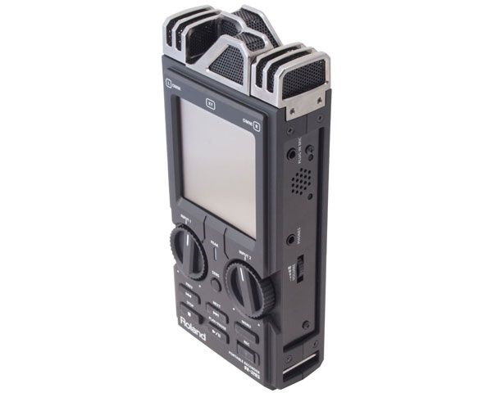
SECONDARY RESEARCH
Audio Material
Using a tape recorder/electronic data recorder to record sound in the form of a meeting it will keep track of what you have done in that meting, you can even record a telephone conversation, this is a good way of collecting information because once you have used the recorded the information and said all the information you need the tape is then used as evidence until you need to use you it again, this is what newspaper writers do before they write their article, in their interview’s. This is also a good way of keeping research information because it can be replayed time and time again whilst you are researching a topic. Audio material can also be bought in shops in the form of CDs. But they are usually not that easy to find, and are usually found in children's book shops. Audio Material can be used through research through the same way as a book. The person researching can listen to the audio material to gain information. This applies mostly to educational audio material, as they usually contain the most useful information and key facts and points.

Slide 15
DATA GATHERING AGENCIES
BARB- Broadcasters Audience Research Board
www.barb.co.uk. From this site we can get the different channel audience viewing figures. The most popular site for the 29th to the 6th of march was BBC one, followed by ITV, BBC2 and then Channel 4. The most popular show in this week from channel 4 was “Goggle-box” and from BBC one it was “Call the midwife”. From the BARB website you can see what people your age or similar is watching and this might make you want to watch that type of program. Magazines and newspapers will include a section of what is coming up in that week and it will include the program channel it is on. They will also include a section about what the basic storyline is throughout. BARB will show the top programs from a particular week.

Slide 16
DATA GATHERING AGENCIES
RAJAR – Radio Joint Audience Research
The RAJAR company works like the rating system for BARB, but instead it does the ratings for popular radio stations. We can use their information to find out the most popular station in that week. RAJAR is responsible for setting the research specification, the awarding of the research contracts to third party suppliers and the overall quality control , management and delivery of the service. The day to day operations are overseen by the Chief Executive and Research Director. The company also shows the averages of the following; hours per listener, the total hours. They get there information from their subscribers views and they will fill out some questionnaires.

Slide 17
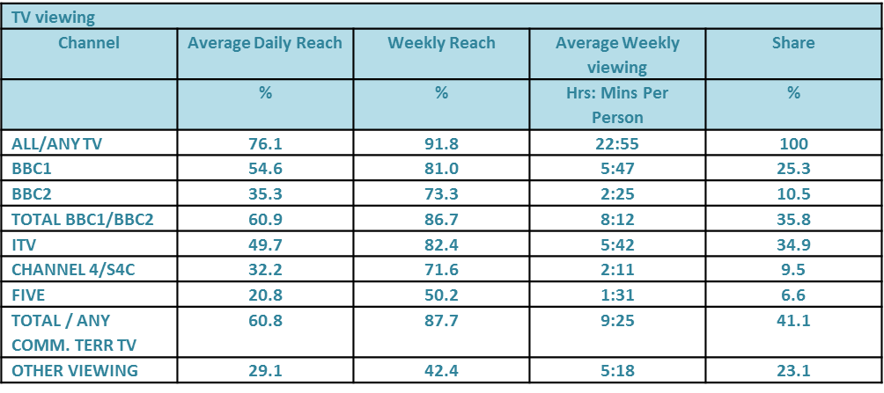
AUDIENCE RESEARCH
Audience data
Audience data is statistical data about the size of audiences for a particular media product, there would be a bigger group of teenage boys would prefer a new game to a book, where as a group of older people would like a book than a game. There are many ways in which use of audience data can provide some different benefits. Examples of which are: an increase in attendances will develop audiences for new strands of work, they will then develop some new audiences for the organisation as a whole. Audience data is how many people are watching a program at any one particular time. You will start by finding data from a range of sources (in this case Tv shows), the data is then looked at and all the unreliable data or data that is not got any prof will be thrown away. Reliable data that can be used is stored and then later on it is analysed to find out any important information. For example if a program was only getting 500 viewers in a day, it isn’t getting the right amount of views and is then therefore taken into consideration that it should be shut down.

Slide 18
AUDIENCE RESEARCH
Audience profiling
Audience profiling is when you set a profile for your audience, they are usually split into different categories this makes it easier for media producers to identify and target groups of people with the same needs and wants. These are the Common classifications; the age group of the audience, the gender of the audience, the culture and ethnicity, the income and social class.
Depending on the persons job can be a type of audience profile, this is split up into one of the following numbered categories. The highest number is 1 and this is for people who are managers or people who own a big company or business. The lowest is people who don’t have a good type of job. Then this is split into your type of working class, this goes from upper class and upper middle class to lower middle class and unskilled working class.

Slide 19
AUDIENCE RESEARCH
Customer behaviour
Customer behaviour is a study of when, why, how, and where people do or don’t buy a product. It will use a lot of elements from psychology, sociology, and others. It will attempt to try to understand the buyers decision making process, both individually and in specific groups, like social groups or with people like friends. It will study the characteristics of individual consumers and will attempt to understand people's wants and what they would like to buy. It also tries to get information of the influences on the consumer from groups such as family, friends, reference groups, and society in general.

Slide 20
MARKET RESEARCH
Competition
The competition is a battle between businesses, this is to gain some customers. This is determined on how well they can advertise their company, a way to find more customers is a eye catching logo or a catchy theme tune. They will battle it out until everyone has that product or they will battle until they have lost or won the customers., to get there interests in the advert they will look at lots of research and they will study them. When your in competition with someone while running a business, then what happens a lot is that one business that your competing against and sells the same products as you, will decrease the price of their products, or have a sale on, or even put in a few deals like you can buy 3 products for the price of one etc. The businesses that are always competing against each other are mostly large supermarkets such as ASDA, Tesco, Morrison's, Aldi etc. This can usually be seen on TV adverts for these companies, as they often compare prices with each others products.

Slide 21
MARKET RESEARCH
Competitor analysis
If a company or a organisation is planning the launch of a product, they will also need to know a lot more information about other companies products. They will need to know what their target audience thinks about their new product, so they will give them a trial period, to test there product out and see if that audience likes it.
Comparing the companies products they need to look at their strengths and weaknesses, who will be working in the same field, so if I created a animation business and use a certain type of software, if another business gets more audience as their software is more up to date I would have to update mine so I can still stay in that league.

Slide 22
PRODUCTION RESEARCH
Content
In media production and publishing, content that may provide some type of value for an audience in specific contexts, i.e. some programmes may contain some violence, sexual scenes and strong language and the viewer is informed of this before the programme starts, so you need to make sure that the audience is suitable. Programmes so usually programmes such as these are shown late in the evening. If you have recorded one of these programmes then want to watch it later on in the day, they may have a restricted password. So younger people can’t gain access. Usually the planning stages for research can be found in the Pre-Production of research, and the final gatherings of data can be found in the Post-Production of research. What is also usually included in the production section of research is finding more data for what you are researching about, and backing up the data that the researcher collected in the pre-production section.

Slide 23
PRODUCTION RESEARCH
Costs
Costs are the total amount of money spent for goods or services, the workers will use their time and labour so they need to get a decent wage. The more of enthusiasm the more you will get out of the experience, this helps if you have a passion to do it. If a company spends too much of their overall budget they will have problems, like their workers will become tired and bored so you need to make a cost list and how long it will take to do.
Some of the different sources of money will depend on the product you are making, but many are common to all forms of media production, they need to make back the money they spent on the advertisement and then gain profit. If you were going to launch a new media product onto the market, whether a newspaper, magazine, television programme, audio product, game or website, you would need to employ people to get your product off the ground and up and running, so you ca then get profits.

