Slide 1
Interactive Media Authoring. Unit 60
Alex Parker

Slide 2
Authoring
Authoring Definition:
Interactive media authoring is a way of using a programs output that then depends on the users input which will then determine the programs output . It also refers to services and products that are on. Multimedia authoring is usually only used on audio visual DVDs and not on music disks.
This is a picture of authoring in interactive media

Slide 3
Authoring
Authoring Tools:
Interactive media authoring tools can enable users to combine different text and graphics, etc. into a interactive project. These systems can help to edit and convert different multimedia clips into different things, whatever the user is trying to do. The system can also try to make visual flowcharts and graphs for whatever the user needs it for. The basic features would be to edit, program, interact, playback features. Tools for making a complete multimedia presentation where users usually have a lot of interactive controls.
These are some authoring tools names and there logos.
You will need a computer.
Dreamweaver
Flash
Director
Fireworks
Photoshop
Adobe Flash Adobe Dreamweaver Adobe Fireworks Adobe Photoshop

Slide 4
Planning interactive media
Planning:
If you were going to need to plan for a interactive media project, you can plan it out using storyboards (drawn on pc or drawn by hand) this may then help you later on when needed, you can also use this later on to look back at if you get stuck with ideas and you get problems.

Slide 5
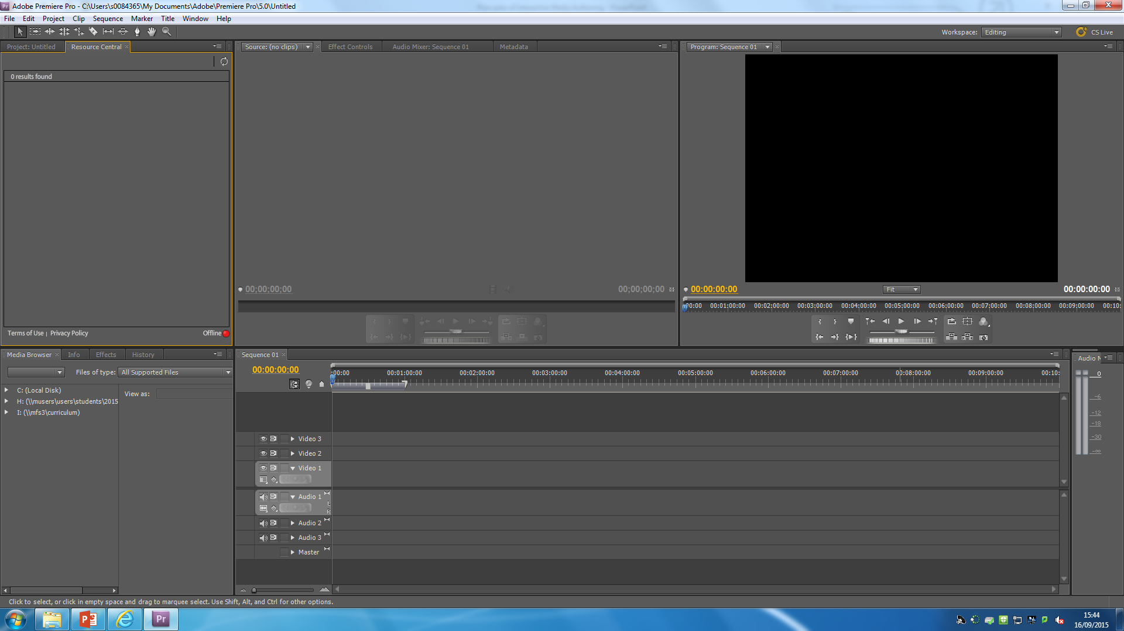
Development and production of interactive media
Development and production
Creating new interactive media and using it takes a lot of new skills this is based on the choice of authoring program. You do need to make different decisions when making; text, sound, graphics, images etc. The developing stage requires a lot of background research and creating ideas of different assets. When developing a movie or film you can use products like Adobe Premier pro.
This Is the Adobe Premiere Pro Layout

Slide 6
Applications of interactive media
Entertainment
Entertainment uses multimedia a lot. This is because they entertain the user, such as DVD, films and trailers witch make the user want to watch the film.
As it is used in film applications, music applications, games and much more.
The games can become more effective if they had music and sounds. This would make the user more entertained.
Multimedia made the gaming industry better, as you can now interact and this has enhanced the learning experience.
Social media is interactive as you need other people to make conversations, liking videos or posts, re-tweeting different things you may find interesting.
These are all different types of social media

Slide 7
Applications of interactive media
Presentations
Multimedia presentations are great ways to introduce and describe new ideas or concepts, this will make the listener know a bit more about the product before they buy it.
The buyer can watch the online presentations as they may tell you something you might not know. This can be helpful if you haven’t seen the product already.
E.G. Apple – Keynote. Microsoft – PowerPoint
Microsoft PowerPoint
This is Apple’s rival and its on most computers.
This software costs money whereas Apple doesn’t cost.
Apple keynote
This is a iOS software/ app that will help you to make presentations on Macintosh computers.

Slide 8
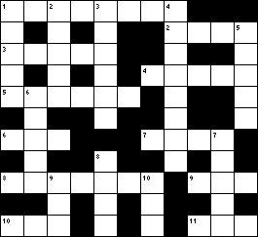
Applications of interactive media
Games
The gaming industry relies heavily on the interactive media, the range covers from online crosswords to first person shooting.
There are different demos that are released by the game owners, so that people can get a good feel about what the game is like.
Games are advertised on other games this is good as the company can have other games that have more users, they can get some of there users… BUT this can become expensive for the different adverts.
This is the logo of Call of Duty, this game is more advanced and more interactive.
This is a picture of a crossword layout, this is a basic interactive game

Slide 9
Applications of interactive media
Education
Multimedia can be used to make the students more engaged. The students can get more involved in their work. Teachers can show students videos that will help them to understand the topic a bit better.
Students after a long time can loose concentration so they can look at videos and sites that can then help them gain there concentration.
Students at GCSE can use sites like BBC Bitesize and they can do different tasks to do at home.
This is the BBC Bitesize logo which will have educational help for students at school.

Slide 10
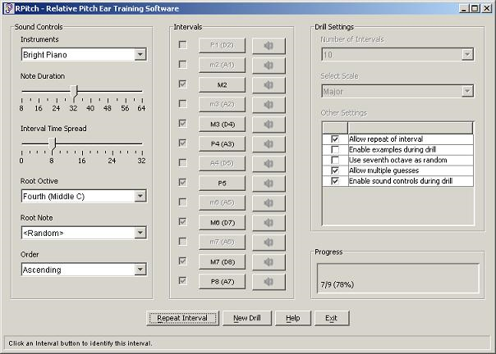
Applications of interactive media
Computer-based training
Applications can be used to help people train for different tasks; cooking, driving skills, etc.
You can also use computer-based training for different software. Like Photoshop as there are so many different features, you can use a computer based software to help you understand more things.
Every year a new updated training software of driving tests come out, this is to help you learn the latest problems you may come across.
This is a picture of a computer- based training software

Slide 11
Applications of interactive media
Assessment
Assessments can be used in interactive media as they can provide feedback to big companies about their service and products. E.g. Sainsbury’s delivery service.
They can also be used in sites like BBC Bitesize as they can assess the students about there subjects. The teacher can then look at the results that the website has produced, they can then know if the student is struggling in a certain area. After they will target the areas of weakness.
This is the Sainsbury’s logo, which is a store that will have feedback assessments.
This is the BBC Bitesize logo which will have assessments for students.

Slide 12
Applications of interactive media
Product catalogues
A product catalogue is a book that shows the customer a list of things there are in that company. They are nowadays on the internet where you will find the websites and through this process you can have products delivered to your door. We don’t use books as they are too heavy but you can still get them if you want.
E.g. Argos computer catalogues.
If the user doesn’t have a disc then they can use the website to download a virtual copy, this would be free to the company and the customer.
This is a picture of a Argos catalogue, but they are usually on a information kiosk

Slide 13
Interactive media Formats
Web
If a user already has a website they might ask you to design it and so it can be shown off. The formats on a website have to be fully thought out.
If the media has a file that is too big then the user may have to wait for a long time, this may not be appealing to other people.
The compatibility of a device has to be taken into account as some sites may only load for a certain device.
Some different browsers don’t use certain formats, so using java on some sites might cause problems and limited access.
This is a picture of a web format

Slide 14
Interactive media formats
CD/DVD ROMS
CD
CD’s are used mainly for different types of music files, But they can also sometimes store interactive videos, information and images. They are normally cheaper to produce, but they do have a file size limit.
DVD
DVD’s are used for videos and basic game demos. A DVD can hold a lot of advanced media , such as high quality video files. They are more expensive to manufacture but they are more compatible.
These are pictures of CD/DVD that will be used to store different storage flies on.

Slide 15
Interactive media formats
Information kiosks
Information kiosks are all over the place, they are here to help you navigate to different places.
They are usually touch screen and running there own programs, they can be programed for different languages. They are simple and clear.
There are a few problems such as they are expensive when they break down, it costs money to maintain and they do ruin on power so they cost in power.
You will mainly see them in shopping centres.
This is a picture of a information kiosks. Which are usually found in places like shopping centres or airports.

Slide 16
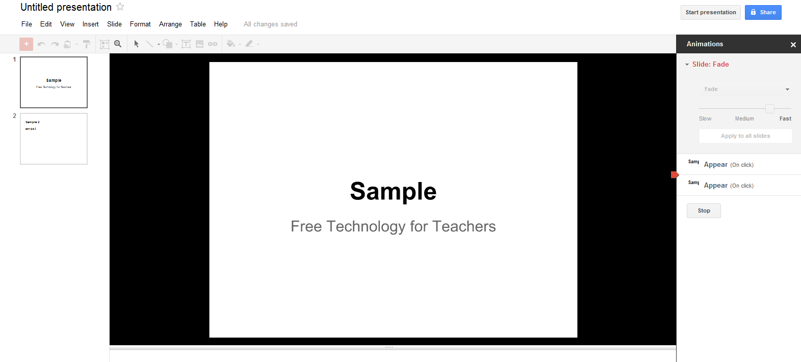
Interactive media formats
Presentations
Anyone can create and use a presentation in software's, such as PowerPoint. But it has to be entertaining and interactive with the audience. You can add videos and pictures to interest the audience.
Presentations are easy to use and to create, The files are not too big and there is range of images, text, sound and video. But they are not to advanced and can’t have interactive games.
This is a basic PowerPoint presentation before you have edited and put information in.
This is the logo of Microsoft PowerPoint.

Slide 17
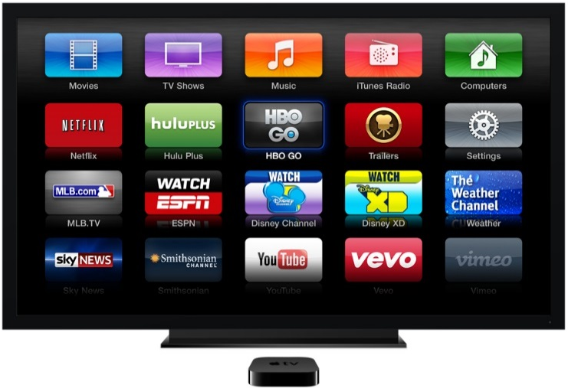
Interactive media formats
Interactive TV
Interactive television is uses techniques that allows users to interact with a program as well as watching them. It is when you watch programs like the X-Factor when you can vote on how good people’s singing is.
The interactive television feature is good for a bit of fun and for the audience’s entertainment.
The Apple TV is a interactive television as you have to interact with it.
This is a picture of the Apple TV homepage, you can watch YouTube, Netflix, sky sports, etc. through this TV.
This is an example of a sports interactive channel

Slide 18
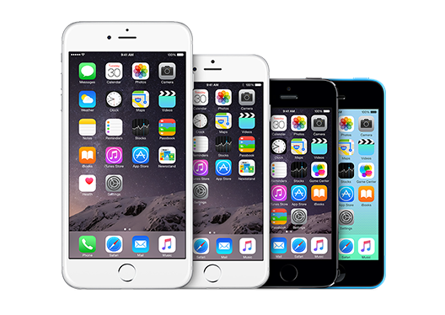
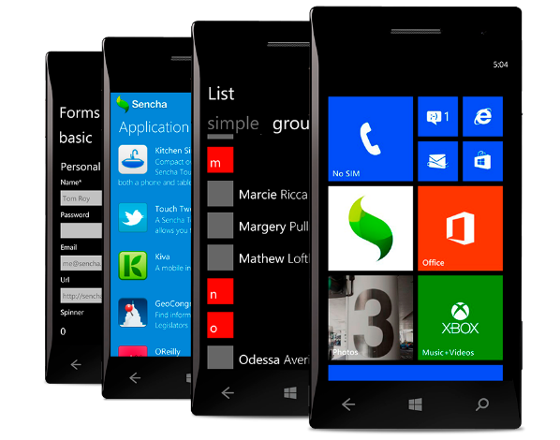
Interactive media formats
Handheld devices
Devices such as IPhones, Blackberries and Windows phones all use different types of interactive media. The development is being created all the time, this means that it is being advanced for gaming, cameras and video quality.
The handheld devices can sometimes look bad and cheep, this can make the manufacture seem as if they have bought out a phone that is not good.
With these devices you get a limited storage space but they sometimes can upgradeable, this can mean that you may not be able to downloads some games or videos as they have a high storage space.
These are pictures of Apple IPhone 6 plus, 6, 5s and 5c (left). The blackberry (middle) and a range of windows phone.

Slide 19
Assets of interactive media
Sound
The sound can be used for aesthetics and can also be used to alert different people.
Sound can be used for games as it can be used to create and add intense, and tension. This can make the player/ user more scared. This can be good when you are horror game creator as you want there to be a lot of tension , before a scare.
Sound can also be used for alerts for texts or calls on a phone, This will then inform the person of any updates, or important meetings.
A personal computer will generate different dull noises to alert you of any viruses or error messages.
Some online marketing use sound to make you feel more engaged, so when you get a cursor that goes on the top of the banner you will get a sound.
Picture of Sound Asset

Slide 20
Assets of interactive media
Text
Text is used a lot in interactive media from menus to in-game.
Text is used in options menu as they can help you to change sounds and sound effects. This can inform them on how to do this.
Text is also used in tutorials as it will help you out in games or in everyday life, e.g. Cook books
Text is used to help you if you have hearing problems, it is done through subtitles. This can help through story-based games.
Picture of a Text asset

Slide 21
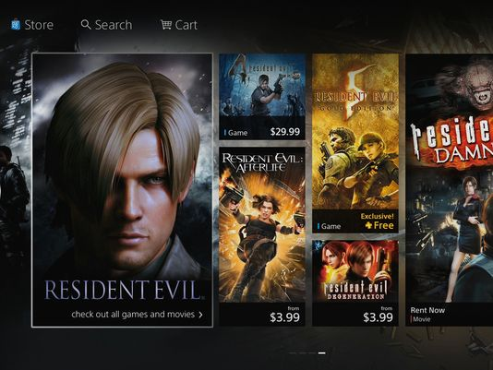
Assets of interactive media
Video
Video games can included different starting and ending clips this can depend on the story paths that you choose.
Videos can be used in online streaming and in apps, they can be for adverts and also YouTube, this is a big online video source. There are other streaming services such as Twitch Livestreaming.
Videos can be made through software's such as Adobe PremierPro and basic programs such as Windows Movie Maker and AVS video editor 7.
Some virtual worlds can implement videos in different ways. Sony’s PlayStation home page like the picture below can help allow you to buy and watch movies and games from a digital world.
This is the logo of Twitch, This is an online gaming livestreaming service. they have videos in adverts.
This is the YouTube logo, YouTube is one of the most famous websites for watching videos.
This is the Sony PlayStation homepage, where you can buy rent and watch videos.

Slide 22
Assets of interactive media
Vector graphics
Vector graphics are created by maths, this calculation can then determine what the picture should look like when resized. This can mean when they are pixelated they don’t lose their quality.
This can be good for logos as they might need to be resized for merchandise or for logos, this meaning they will look good on anything.
In 2D games vector graphics are used for the characters as when they are resized they won’t get pixelated.
These vector graphics can be made in Adobe Illustrator. Like the photo of the knights made.
This is a picture of a vector graphic and if you increase it, The picture will not go pixelated.

Slide 23
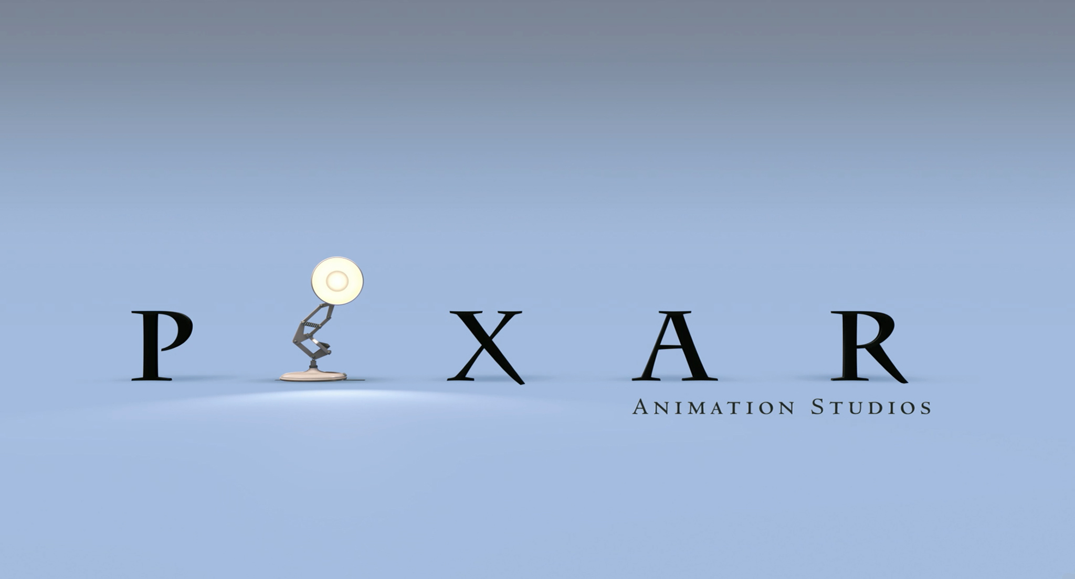
Assets of Interactive media
Animation
Both of 2D and 3D animations will use interactive media products. They have a lot of uses;
In animation of assets this the characters, animals and backgrounds that are created in animation.
In animated logos, this is the developers splash screen that will be recognisable and memorable.
In animated loading screens, this may have animation a sheep jumping up and down, this can be entirely up to you.
These animations are created in Adobe Flash or Adobe Illustrator.
These are the logos for Adobe Illustrator and Adobe Flash, with these programs you can create your own animation
These are logo's of Walt Disney Animation studios and Pixar Animation studios, These are two animation companies that are big.

Slide 24
Assets of Interactive Media
Images
The use of images in interactive media is incredibly common and is used to aid the user as well as using text.
Company logos are images that will be colourful and bright this can then help the user remember the sites as it is memorable.
Images are used in stead of text on in-game control as this can save space on the users interface. This is easier to see than a lot of text.
Images are used as menu icons this includes them in web browsers, icons to mute and unmute games.
There are many software's from basic Microsoft Paint to expert Adobe Photoshop and Illustrator.
These are the logos of Adobe Photoshop and Adobe Illustrator, these programs are for expert artists.
This is the logo of Microsoft Paint, which is a basic drawing software

Slide 25
Interactivity and control
This is the Adobe Photoshop CS5 toolbar
Buttons – These are virtual buttons that when you can click with your mouse it will do a certain command or do something different depending what button you click.
Events – These are controls that tells the program what the product does, for example if a image appears or a animation starts.
Hotspots – These are the areas of interaction, and they are boxes or buttons that is a outline and when you go inside them they will go a different colour. If you don’t have one then the buttons won’t work. These are also hyperlinks.
Scripting – This is a programs code, this will determine what the user wants to happen. This is the script that when you want to go to the homepage you click on the home button and it will take you there.
Timelines – These are boxes that show you how much time you have spent on making a animation or film, in small key frames which are seconds.
Slideshows – They are a way of presenting information or work, this is done with a play button instead of using manual controls, E.g. PowerPoint.
Effects – These are effects in programs such as Photoshop which you can edit photos and images with tools such as; Blur, Glow, Smudge, Clone stamp, Sponge tool and there are many more.
This is the timeline from Adobe Flash CS5

Slide 26
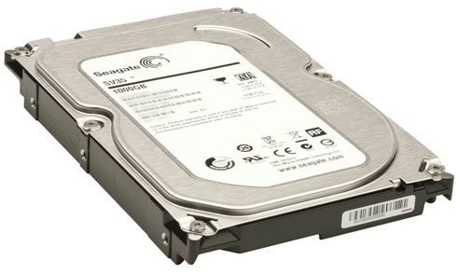
Limitations
This is a hard drive that is used to store different amounts of data
Size – With all the multimedia products there are a lot of problems in size, each multimedia product has a range of storage size. This is hard for people who a small hard drive space, as there storage will always be a problem if you create videos.
Download time – If you have a fast internet speed you can download files, music and other things a lot quicker than if you had a person with a slower internet speed. This is a big struggle for internet companies as they are trying to produce the best.
Type of content – You are going to get different limitations of content on the internet this is due to having blocked sites for Pornographic sites, Hacking sites, Drugs dealing sites etc. There will be more at a school than at a house.
Requirement for plug-ins – A plug-in’s job is to make a web browser or software customizable, this is good as you can add some more different functionality. But there are some problems and limitations, if you download a plug-in it may also be a virus. The person who made the plug-in may then be able to see bank details, etc.
This is the logo for google chrome plug-ins
This is the kind of message you will get if you try to access blocked sites

