Slide 1
Panda Prince
By Alex parker

Slide 2
Usp and “1-liner” sales Pitch
The 1 liner sentence that I have gone for is “Help take back our kingdom”. This tells the audience a lot about the game before they have even started to play the game, it is also short snappy and gets to the point.

Slide 3
The game 1
This game is unique as their isn’t a lot of games like mine around.
The new game that I am going to be creating is a story based game with the use of Multiplayer to get the crown and the throne back for a character called Paul the Panda. Along the way you will have to go through lots of different levels in order to defeat the evil Francis the monkey. The game is designed to allow you to advance your different skills online and offline. The way to beat the game is to group up with your friends that are at a certain level and then they have to defeat the BOSS at the end. But before then you just need to train with battles and the other monkeys in the armies at certain levels to get enough experience to level up. The game is going to be interesting as once you finish the game you can then just keep on levelling up and getting more armour so you can just keep on battling your friends, this is what the multiplayer section is going to be incorporated into the game. You will also have your own game character and then Paul the Panda follows you around and then you get advice and he tells you how to get through that section.

Slide 4
Timeframe for production
The production of a normal game is about 2-3 years, but if you want the game to be good with good graphics then you need to make sure to spend a adequate amount more so that the game is bigger and better than you would have thought.
My game will take about 2 years as the game wouldn’t be that hard to make and therefore the process will be cut down a lot more.

Slide 5
Market research
Market research for a game will be a big document as there are thousands of games out their and therefore I have compressed it into the following:
I will be using the market research for my game, this makes it easier to make the items for the games as I would have done the relevant research for it. The game I will be making is going to be about a Panda Prince that needs to fight his way back to become the king and take his place and therefore this game is going to be a multiplayer game as then you can tag along with the other characters to get to the top. The BOSS at the end will be so hard that then you will then need to tag along to get more specialist people to defeat it at the end. So this is going to be MMOG (Massively Multiplayer Online Game). Therefore, the game needs to be exciting and fun and this will be done like a cartoon style and this will be fun for people who are into new cartoon fighting games.

Slide 6
Target audience
The target audience is for the game is going to be people that like games and they will like the concept of the game I will be making is going to be for people aged 18+ and people from both genders will have fun as it is a unisex game and therefore the gender doesn’t matter at all. The reason why it is going to be 18+ as it will contain blood and gore and has some use of weapons, they aren’t going to be guns and things but it does have daggers, spears and a lots more weapons. The gender for games like mine is surprising as most people that use it are going to be able to enjoy things. The audience will be what everyone likes and that is good. A lot of people that aren’t in this category can also play the game as well.

Slide 7
Platform
There are many different platforms that you can play different games on. The three devices I want the game to be played on is the Desktop Pc, PlayStation 4 and the Xbox One. The Desktop Pc version of the game will be available on the Steam store as a lot of people use this as a main pc gaming driver and this means that the game has to be optional for 4k gaming. The Xbox one and PlayStation 4 are both great consoles and this means that they are going to be able to play the game. The games do have slightly different controls but this is something that I can talk about in the game mechanics and the game controls later on so people know what each button does.

Slide 8
Characters
For this game I have a few characters for it, the character that you will be able to play on is the main one that you can adapt and edit but that should just be quick and simple to do. The other characters are going to be guides and that should be good to do and the characters will be easy to control. I have some basic sketches from the last assignment bellow and the final designs are going to follow later on.

Slide 9
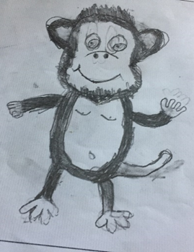
Characters
.

Slide 10
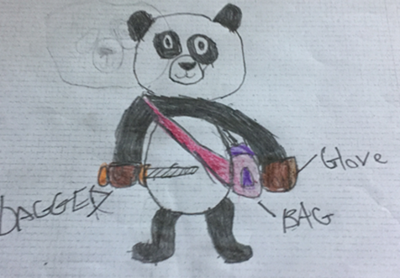
Characters

Slide 11
Cost
Online people say that the game can take a number of years and a lot of money, for a big video game it can cost the company more than 30 Million dollars. But the my game budget will be less as I don’t have a well built company.

Slide 12
Game Structure / mechanics
The game is going to be played as a Pc game and the mechanics will be good as they are going to be about how to control the game and then the game will be exciting and fun the mechanics of the game are basically how and what you would do to play the game. The WASD keys are going to be forwards, backwards, left and right the space bar will mean that you jump and the shift key is how you would crouch and squat from other players. These keys are universal and this is what people use to play games with it.

Slide 13
Thanks for watching

