Slide 1
Advertisement pitch
By Alex Parker

Slide 2
Intro to Project
This project is going to be a advertisement, the advert will be promoting a new pair of trainers. The project will need to have a lot of things to have gather such as research into the competitors and the market. I will also create the logo, name, shoe model and so forth. I have already thought of the name and it is going to be called SpeedFire.
The advertisement is a big industry as you can gain a lot of customers from it. This can sometimes mean that people are going to loose as well, this is because they are placing a bet on things.

Slide 3
Product Information
My product is going to be a new brand of trainers. The trainers are going to be called SPEEDFIRE. I have created this name as it makes it seem as if the person that will wear the shoes will get faster with them on.
This product will be available in 7 different colours/ patterns, but for the purpose of the video it will be dark grey or black.

Slide 4
Full Content Outline
I am going to be creating a advert for a new brand of trainers. This is going to be for people aged 16 – 21 as they are students. Like myself

Slide 5
Target Audience
  The target audience for my shoes is students aged 14- 24, this is why I have made the advert to be connected to the age by making it engaging and interesting for them.
  I have also priced the shoes at £30 this means that they will get some more sales and this also means that they aren’t too cheep but they aren’t dead expensive.

Slide 6
Resources
For this project I will need:
A editing computer → Edit the footage
A Camera → Record it
A new pair of shoes → As the Speedfire’s
A old pair of shoes
Tripod → keeping the camera steady
Microphone → Record the sound.

Slide 7
Personnel Requirements/Jobs
I will need to have a job table this will telling what jobs that people will do, this will help when we are filming.
Myself→ I will be acting in it and I will also be the speaker, I will also have the job of doing the edited.
My Brother → He will be doing the filming and the tea/coffee man.

Slide 8
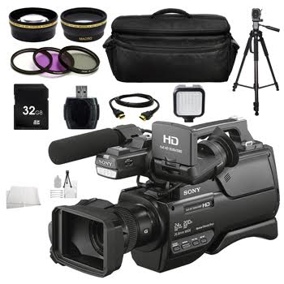
Budget
For this project I have been given £4,000 to spend on items:
I will need to get a camera, Tripod, Computer and editing station, and maybe a microphone.
I have found online a good camera which comes with lots of accessories: this is all the things that I will need, this is all for £999.00
The money I spend is: 2,687.97 – This means i have £1,312.03 to spend on bus travel and other equipment if needed.
Notes:
Camera: https://slrhut.co.uk/product/ID862C6/google?gclid=CL7h_JeXm88CFeQK0wod68YCkw

Slide 9


Budget
I have also found a good computer that will do what I want with it: this has enough ram to hold the programs on it and this also had a 1TB of storage on it and this is enough to keep the files together, it is also a good price at: £289.97
I also needed a program to edit the footage in: this is going to be adobe suite I will get the CS6 section, I have found the whole suite for £1,3999 at a website and this is a bit pricey but this will do the job that I need.
Notes:
Laptop: http://www.pcworld.co.uk/gbuk/computing/laptops/laptops/hp-pavilion-15-ab270sa-15-6-laptop-red-10138120-pdt.html
Adobe CS6: https://www.kingofsoftware.co.uk/adobe-cs6-master-collection-for-windows-full-edition-electronic-download?___store=default&utm_source=GoogleShopping&gclid=CL2g3amam88CFQuNGwodnYsA0Q

Slide 10
Project Schedule
The project schedule will hopefully only take about a week; I will need to get the assets, the equipment, I will also do the filming and the editing in this time as well.
The editing and the asset collection can be done in the lessons that I have and the filming will be done at the weekened or on a Friday when I have the time to do so. There isn’t a lot of things that I need so the schedule will take a bit of time.

Slide 11
Project Fit/Market Research
The market we are looking into is the shoe market, footwear is a popular market and it has not left much opportunity for new ideas which have not already been used, by other companies. This would mean that I need to generate my own ideas. Rather than looking at the design and materials used in just trainers it would be wise to research the entire market, looking at different types of shoes. I have noticed with my own use that most shoes are made for comfort and style offer little to no support, however the more practical shoes or business shoes are supportive but have a lack of comfort. This means that I can use this to my advantage as I can make them comforting, supportive and stylish.
The global footwear industry has been experiencing rapid expansion, primarily due to rapid demand for new and innovative footwear products worldwide. Due to advancements in manufacturing processes, technology innovation and integration, modern, trendy, and comfortable shoes are being continuously developed at reasonable prices in order to keep pace with the growing demand for these products. Different international brands are merging sportswear with fashion wear nowadays. In addition, there has been a surge in health and fitness activities among consumers worldwide, particularly in running and other sports. This is leading sports brands are continuously involved in the manufacturing of technically sophisticated and innovative products. The following are the biggest places in the world that in the footwear market: U.S, Canada, Rest of North America, U.K., Germany, France, Russia, Italy, Rest of Europe, China, India, Japan, Australia, Rest of Asia Pacific, South America, Middle East, Africa

Slide 12
Planning/Milestones
When doing this assignment I will have some Milestones to make sure I do some feedback to whatever I need. The milestone is an important thing as I can review what I have done over some small periods.

Slide 13
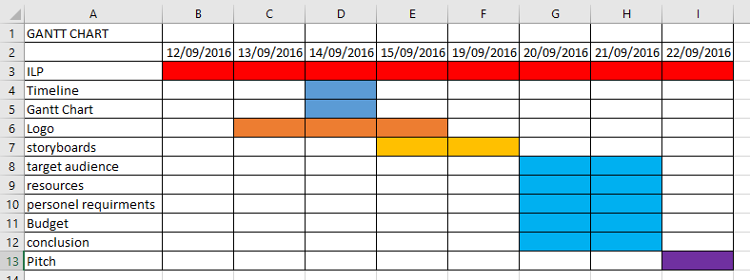
Planning/Gantt Chart
A Gantt Chart is a coloured document to keep me up-to-date with what I need to do.

Slide 14
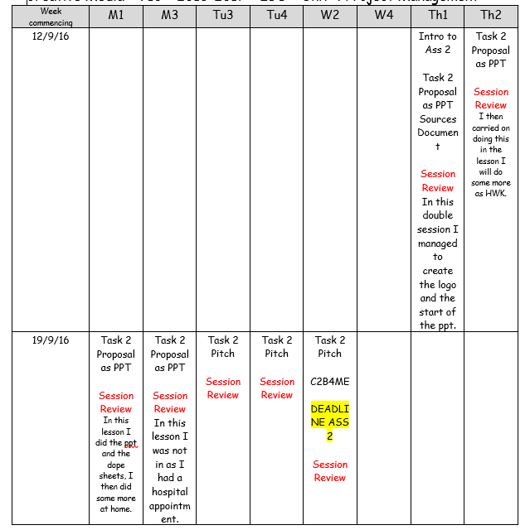
Planning/ILP
The ILP is a Individual Learning Plan,
This means I can stay up to date and this
means I know what to do in that lesson.

Slide 15
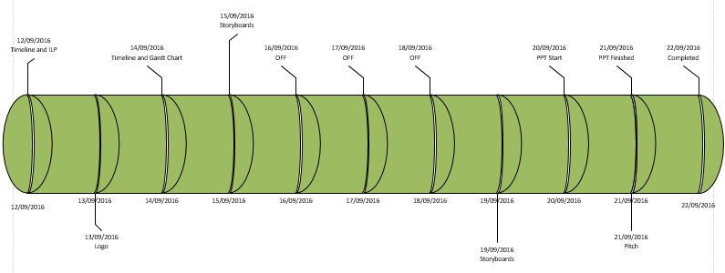
Planning/Visio Timeline
This is a Visio Timeline:

Slide 16
Clearances
I will not need any clearances as their wont be anyone in their apart from myself and this means that I will not need anyone in it.

Slide 17
Dope sheets
This is the 1st dope sheet.

Slide 18
Dope sheets
This is the 2nd dope sheet.

Slide 19
Logo
The logo for SpeedFire is this:

Slide 20
Conclusion
I will make my video as eye-catching and as good so that people will look at them and be rememerable to it. I will create this in a high quality standard as well.

