Slide 1
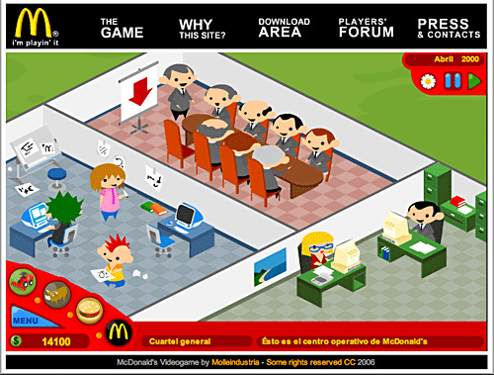
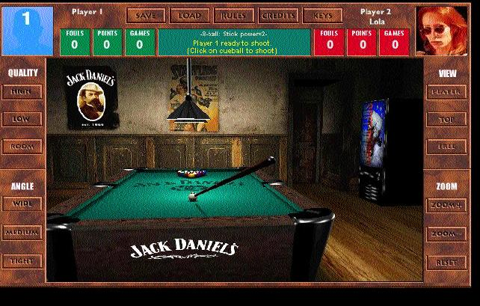
Advergames Pitch
By Alex Parker

Slide 2
Introduction
Hi, my name is Alex Parker, I will be telling you about Advergames. This PowerPoint will be showing you how I will make a short film or documentary for Channel 4 on the effects and issues of Advergames that may affect the younger generation of people’s lives.

Slide 3
What is an Advergame?
DEFINITION:
Advergaming is a new advertising media that is being used by many companies to brand and market their products. The word origin is a blend of advertising and game. This means that they will make some type of game to get customers or any money. The most effective one of these is the McDonalds Monopoly.

Slide 4
A bit more about Channel 4
What is channel 4?
Channel 4 is a British television broadcaster that begin its first show in November in 1982. It is mainly commercially self funded. The channel 4 mainly focuses on documentaries, culture, media and sport.
The average views?
The average views for channel 4 in a week is about 32,765 this means that you are going to be getting a lot of viewers, this is a important key in getting money from the views, the more the better. This is the view
From the week of 10th April.

Slide 5
The Program
The title: Advergames
Target: Is mainly 14yrs – 20yrs, but viewable for everyone.
Day: It will be a Friday, more people will watch it.
Time: It will be from about 8:30 – 9:00. This is a 30 min program.
This means that their will be at least one advert.

Slide 6
The Program Structure
The opening credits and some music (This music will be retro)
Then there will be a intro to the program and what an Advergame is.
Then there will be a section about how a Advergame gets its views and people.
There will then be the presenter which tells us about their interview, (includes a few clips)
There will be a section of this which is the public on the streets options about them (With clips)
ADVERT- THIS WILL BE ABOUT 3 MINS.
Then it will show a bit about how to create a Advergames (what Software they use)
This section will tell the audience how to create one effectively to get the max audience.
Then the program will show the audience about the industry and how it is changing.
Then the program will tell them the amount of customers they can obtain through them.
Then their will be the ending credits and the music will play. This is the sign-off.
Beginning
Middle
End

Slide 7
BUDGET
Presenter: £10,000
Interviewers X2: £5,000 (£2,500 each).
Staff: Researchers: £1,000, Director: £2,000, Editors: £1,000. £4,000.
Locations: America: Interviewer and the crew would be = £7000. (Includes flights and hotel)
Camera+ equipment: 4 cameras and tripods. External boom microphones which are £200 each, this is overall = £7,800.
Computer and software: An iMac £1,000, and Adobe suite which is £1,000. So £2,000.
Permission fees: About £500 each so this should overall be about £1,000.
Van Hire: 7 days. I have found a van + insurance + drivers + fuel = £828
The budget of 40,00 - £37,628= £2,372 For extras

Slide 8
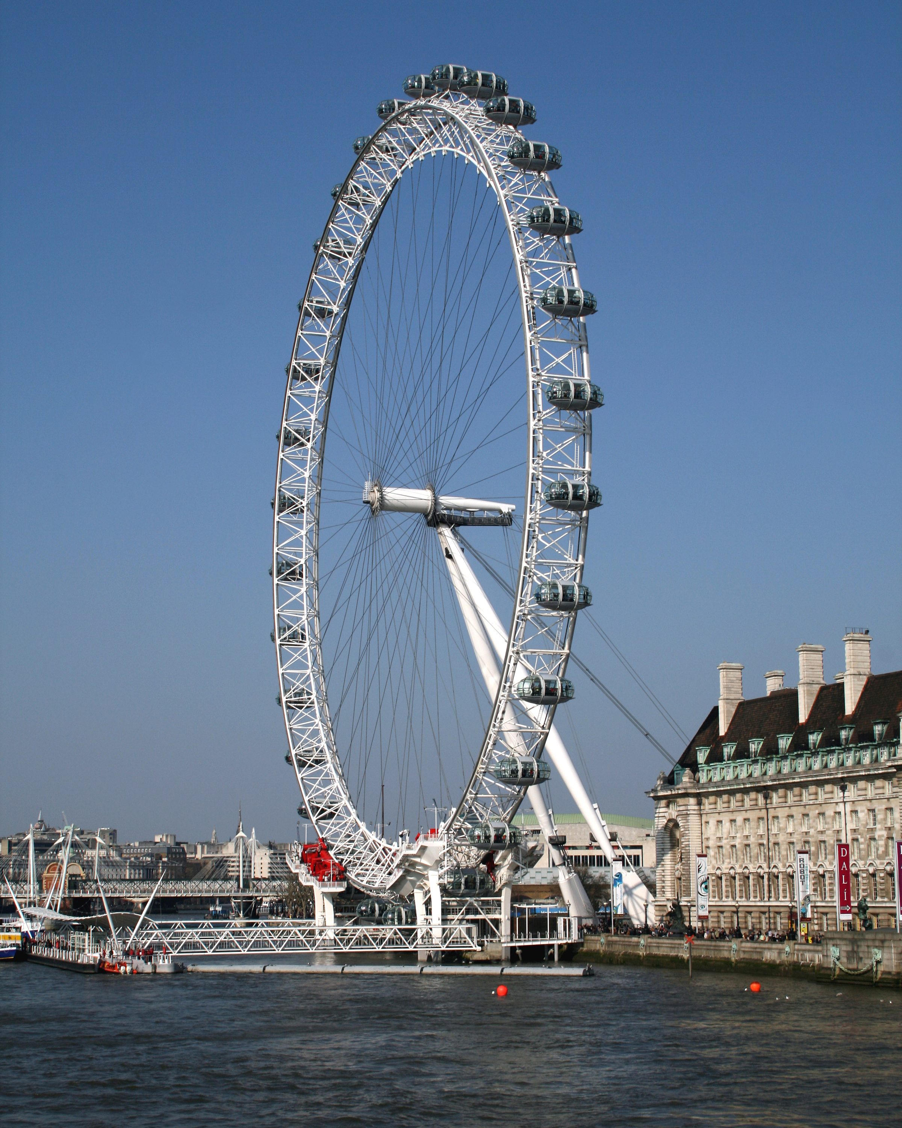
Location
The main location will be London, this is going to be near the London eye. I will ask the London government to ask for permission to shoot in this area.
The secondary location will be in America in the McDonalds main HQ. I will make contact so that we can do this.

Slide 9
Reccee
A reccee is a person that goes to places to find that ideal place, to shoot the film.
I will need one of these to take place for a day in London, to find a suitable location for the filming.
I will need to find a suitable room in the McDonalds offices to film, this will need to have enough room to film in.

Slide 10
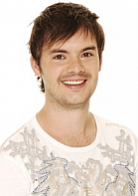
The Talent (Presenter)
I have chosen Barney Harwood as my talent.
Why?
He is well known from Blue Peter, I need someone who is at that age where people will enjoy it. He has been successful in doing a lot of children's and teens programmes.
How much is he?
I was going to spend about £6,000 - £8,000. I will speak to his agent for figures for a week. If needed to I will go up to £10,000. I have allowed this max in the budget.

Slide 11
Schedule Time
Planning and researching: I will allow for 2 weeks of research before the interviews.
Interviewing: I will allow the interviews to take place for 1 week in America, but 1 weakened for the London interviews as there's more people.
Filming: I will be filming with Barney in the week as this gives more time, if the weather is bad on one of the day’s.
Editing and Publishing: I will have another week to let people edit the footage, they can edit the footage of the interviews in the week before to allow extra time.
I want this all done by the end of a month.

Slide 12
Secondary research
Readership circulation figures.
This is the amount of copies a publication has disrupted.
I found out that the amount of money that has been gained from this is about $3billion.
This was mainly done through social media and new technology, like a smartphone, tablet and Twitter and Facebook.

Slide 13
Secondary Research
Hits on a website
Advergames will bring in more views on a website. The big companies that can afford it will give the customers some type of freebies or coupons.
YouTube has a few videos that tell the watcher about the top 5 or the top 10 Advergames on the market. These have reached about 45,000 views, with about a thousand likes.
This is the link: https://www.youtube.com/watch?v=ydCIlyYLAqk

Slide 14
Primary Research
Questionnaires
I asked ten people in my questionnaire to ask about Advergames. I got a lot of feedback, the main one being that they don’t really know what one is and they don’t know how to access it.

Slide 15
Questionnaires
These are a few of the questions that I asked 10 people

Slide 16
Audience Research
Age:
The age that mainly use Advergames is between 14yrs- 20yrs, so I will target this in the show, but I will make sure it appeals to everyone. The main age that people start to use them is about 16 when they can claim their prize.
Occupation:
The occupation doesn’t really matter as anyone can use them, but the main people that will use it will be students as they have more time on their hands.

Slide 17
Market Research
Competitor Analysis
Competitor analysis is an important part of Advergames as you can find out what people’s favourite type of game is.
To find these things out you can ask the audience by setting up a questionnaire or some interviews.
The main thing that you want to find out is why they enjoy or like the Advergames. You can show the audience a few of your games and then from that you will know which one they prefer. This will get the most customers.
If I owned a business that sold burgers, I will have to look at the following companies to find what their Advergame is about; McDonald’s, Burger King, KFC, etc.

Slide 18
Market Research
Advertising effectiveness
The advertising effectiveness is essential to building a Advergame as it is pointless if it isn’t effective.
The company will have put time, effort and money into the game so overall it needs to be effective.
The company can run a test to see if it works, by checking the sales numbers from the month before and then the month after to see if they have made a profit. I can tell the users how to make an Advergame effective. I will have help from people during interviews telling me the key information.

Slide 19
Evaluation
This documentary will tell the user about Advergames and this might inform them about something they might have heard about, if not they will learn a lot about it.
I think that I have done the right amount of research. If I needed to, I can employ more people to do this.
I hope that you will chose my topic, this is because no one really knows about it, therefore if they owned a bussiness they might learn from this and they can create one of their own to gain customers.

Slide 20
Thank you for listening to my pitch
Any questions??

